Slide 1
Analysis of
Salary Variation
in San Francisco
Group 3: Julia Buano, Adony A. Oliva, Ismhael K. Asturias, Samuel Maingi, Nicholas Cun
CIS 3200-01 (92845)
Dr. Jongwook Woo
December 1, 2025

Slide 2
Agenda
Abstract
Introduction
Dataset Overview
Our Work
Relevance to Class
Implementation
Data Analysis
Predictive Analysis with ML
Conclusion
Q & A

Slide 3
Abstract
This project examines compensation data among San Francisco city employee compensation, using the SF Salaries dataset (2011-2014).
Key Findings include workforce distribution patterns (Top 1000 jobs) and pay disparities, leveraging Elastic Search ML for cleaning and aggregation.
ElasticSearch was used for large-scale data indexing, cleaning, and aggregation. ElasticSearch ML, Cloud, and visualization tools helped provide insights for budgeting and HR decision-making.

Slide 4
Introduction
Importance
  Inefficiencies with personnel management and budgeting can cause compensation imbalance.
  Public salaries are significant portions of municipal budgets.
Objective
  Identify potential inequalities and overtime dependence.
  Support public policy decisions regarding pay fairness.
Research Approach
  Use ElasticSearch to aggregate data points, perform scalable data analysis, and generate actionable insights.

Slide 5
Dataset Overview
(Content)
Dataset Size
14 MB approximately 150,000 rows
Timescale
2011 - 2014
Dataset Attributes
Job Information:
Job Title & Department
Employee Details: Employee ID & Employee Name
Salary Details:
Base Pay, Overtime Pay, Other Pay & Benefits

Slide 6
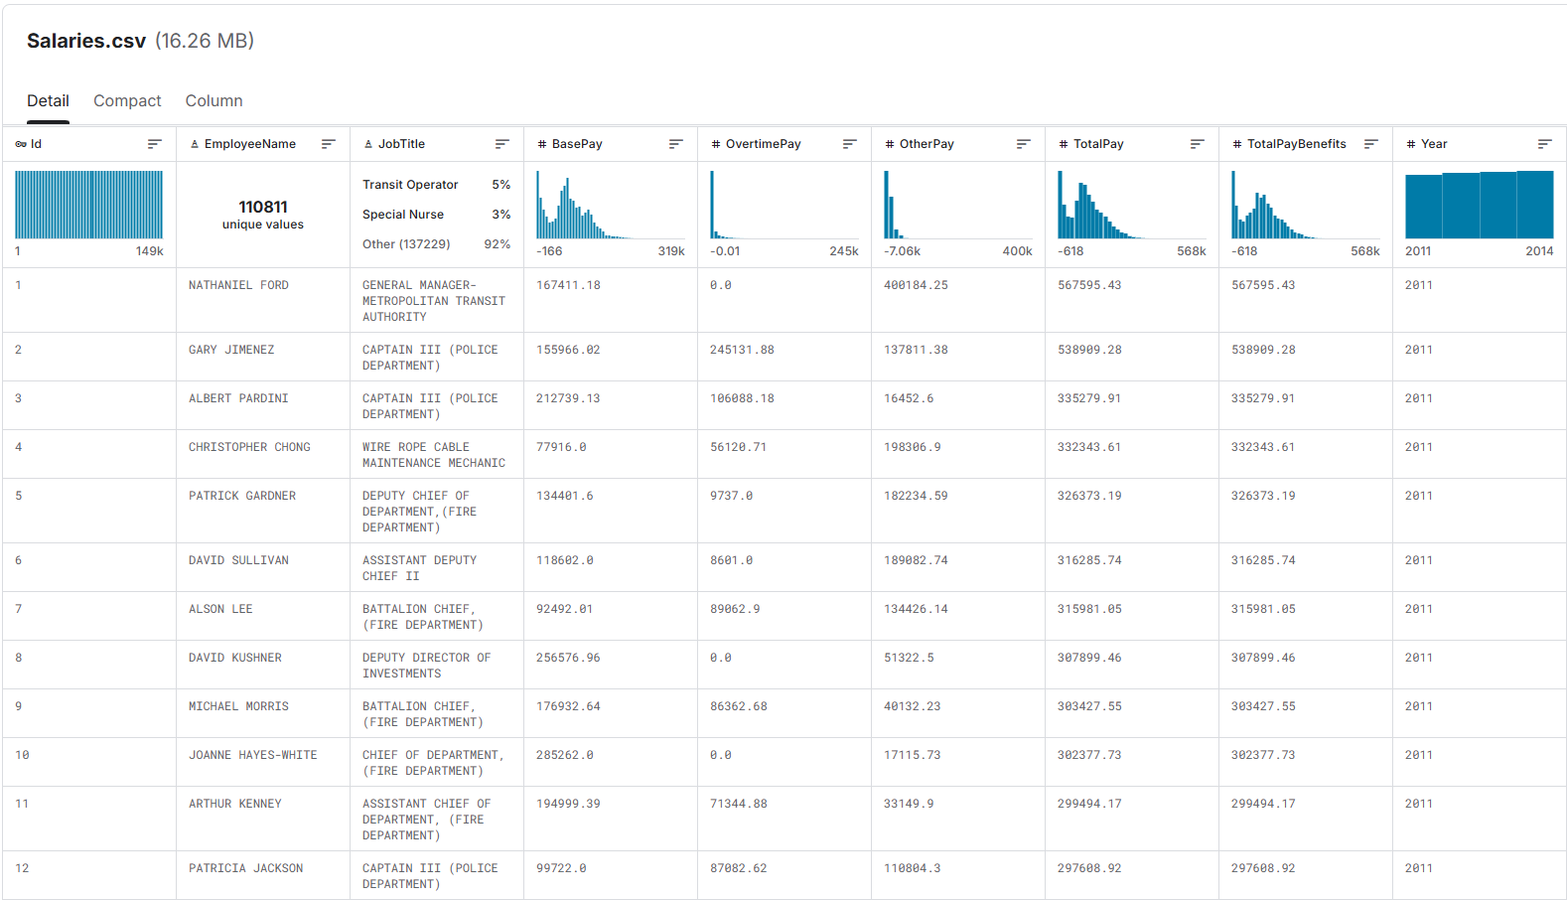
Dataset Overview

Slide 7
Our Work
ElasticSearch
Machine Learning
Visualization
A visual reporting of workforce distribution
Compare with available public payroll records for comparison
Performed regression analysis on the data set
Our model received a 90% accuracy score
Created dashboard
Treemap to illustrate job spread

Slide 8
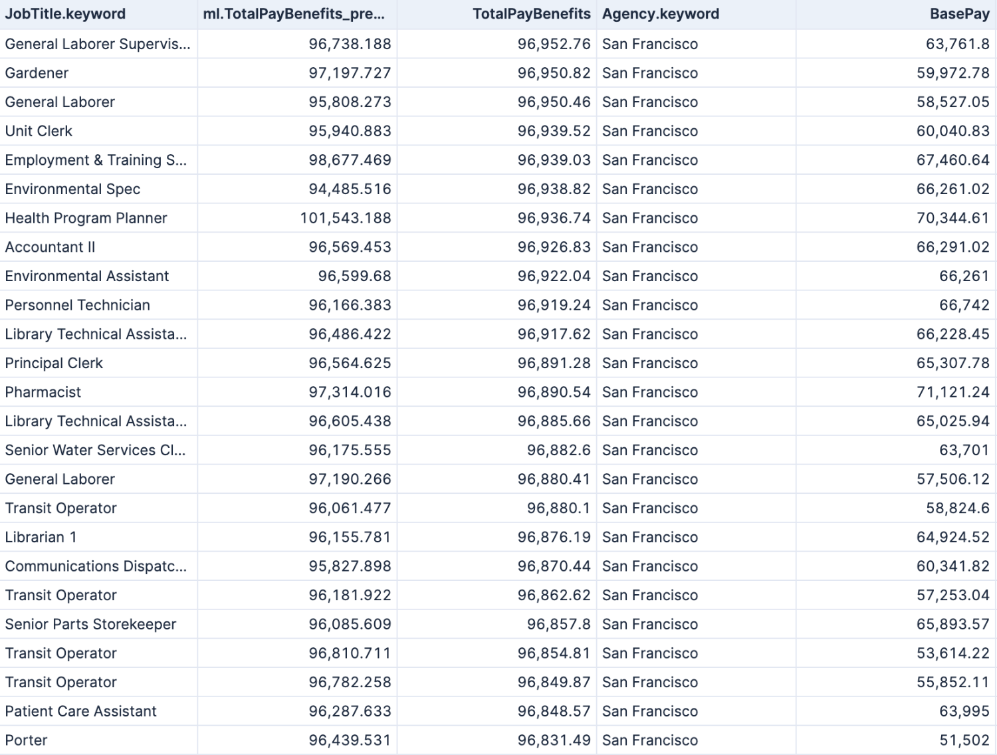
Implementation (KPIs)
Key Performance Indicators
JobTitle shows leading jobs in the San Francisco area
TotalPay benefits is the accumulation of total compensation after all other pay had been added
BasePay indicates hourly compensation before benefits, overtime, and other pay

Slide 9
Implementation (Data Engineering)
Key Implementation Steps:
Data Upload : Imported CSV using Elastic ML Data Visualizer.
Data Cleaning: Handled missing values, normalized compensation fields.
Mapping Fix: Added keyword sub-field for JobTitle to resolve ML errors.
Reindexing: Moved data to new index sf_salaries_fixed.
Modeling: Created regression ML job.

Slide 10
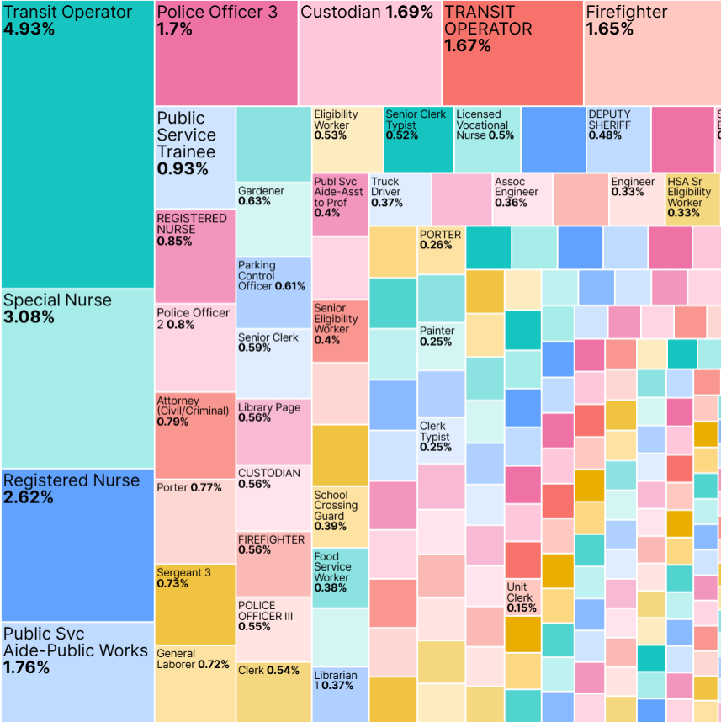
Data Analysis: Job Title Treemap
Insights
Transit Operator is most common role (4.93%).
Public safety and transportation roles dominate workforce distribution.
Visualizes workload distribution across municipal jobs.

Slide 11
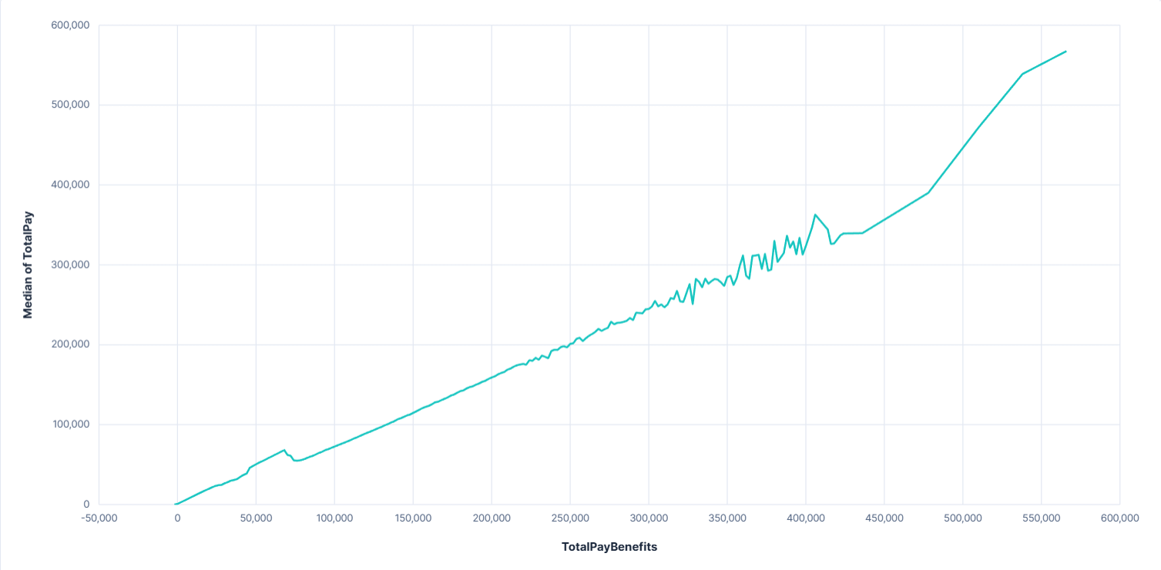
Total Pay and Total Pay Benefits Comparison Graph
Insights:
Strong correlation between Total Pay and Total Pay Benefits.
Benefits significantly increase total compensation.

Slide 12
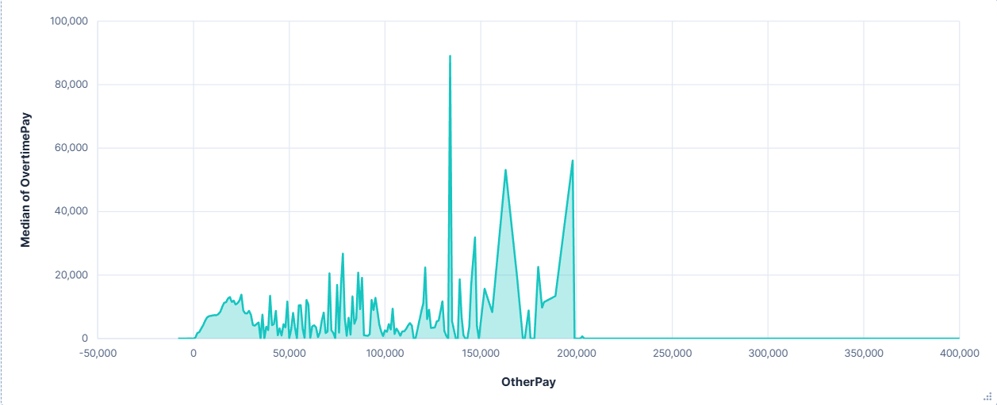
Overtime Pay and Other Pay Comparison Graph
Insights:
Large fluctuations in Other Pay reflect job-specific bonuses.
Overtime spikes in certain roles indicate staffing shortages or high service demand.

Slide 13
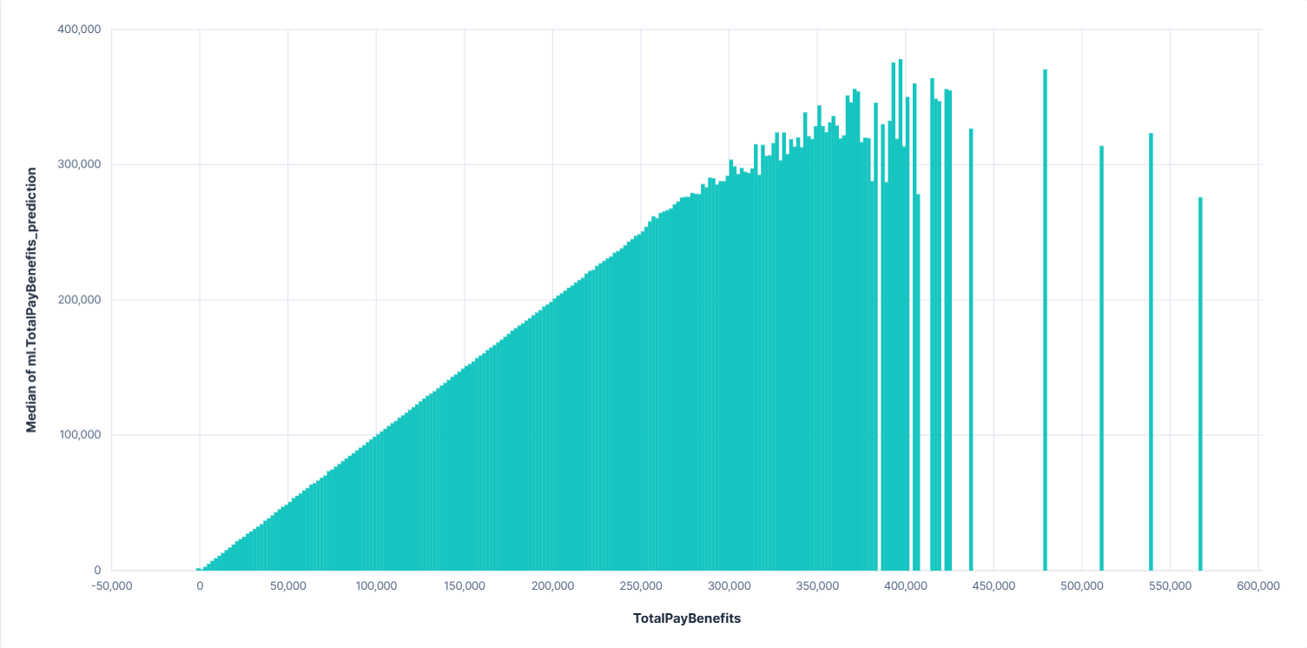
Predictive Analysis
Model Details:
ML Method: Regression
Target Variable: TotalPayBenefits
Inputs: JobTitle.keyword, BasePay, OvertimePay, OtherPay, Benefits
Training Data: 90% accurate prediction

Slide 14
Model Influencers
Top Influencers Identified by Elastic ML:
JobTitle.keyword (strongest)
BasePay
OvertimePay
Benefits
Interpretation:
Specific job roles heavily determine pay expectations.
Benefits meaningfully shift compensation rankings.

Slide 15
Model Evalutation & Accuracy
Model Metrics:
RMSE (Elastic default)
Prediction distribution aligned with actual pay patterns
Small residual error for high-frequency job titles
Conclusion:
Model accurately highlights salary drivers and inequality patterns

Slide 16
Relevance to Class
We applied ElasticSearch tools such as mapping, indexing, querying, and machine learning analytics to manage and interpret a large real-world dataset.
We created dashboards and visualizations, demonstrating our ability to translate raw data into meaningful insights.
We performed time-based analysis to understand salary trends.
We built and interpreted a regression model in ElasticSearch.
We evaluated model accuracy, demonstrating our ability to assess the reliability and effectiveness of machine learning results.

Slide 17
Key Findings
We discovered that compensation differs significantly across job titles and departments, showing how data analysis can uncover structural pay patterns.
We observed high reliance on overtime in public safety roles, demonstrating our ability to identify operational and staffing trends through the data.
We found that benefits substantially increase total compensation, reinforcing what we learned about analyzing multi-component salary structures.
We noted gender and positional disparities, which highlighted how analytical tools can reveal deeper equity issues within the workforce.

Slide 18
Recommendations
We recommend auditing job titles with unusual or disproportionate compensation, applying our analytical skills to support fair pay evaluation.
We suggest reevaluating overtime distribution to address inefficiencies identified through our data findings.
We encourage greater transparency in compensation structures, using our insights to promote clearer and more equitable salary systems.
We recommend reviewing benefit allocation to ensure fairness, based on the disparities revealed by our analysis.

Slide 19
Conclusion
Used the full range of skills learned in class to analyze close to 150,000 salary records using ElasticSearch.
We used machine learning regression to identify the key factors that influence total compensation
Created dashboards that transformed complex salary data into meaningful visual insights.
Overall, our findings highlight how data analytics can support more equitable and informed decision-making in public administration, showing the real-world value of the tools and methods we developed throughout the course.
Notes:
Through this project, our group applied the full range of skills learned in class to analyze more than 150,000 San Francisco salary records using ElasticSearch.
We used machine learning regression to identify the key factors that influence total compensation, which strengthened our understanding of predictive modeling and influencer analysis.
Overall, our findings highlight how data analytics can support more equitable and informed decision-making in public administration, showing the real-world value of the tools and methods we developed throughout the course.
Created dashboards that transformed complex salary data into meaningful visual insights, demonstrating our ability to communicate analytical results effectively.

Slide 20

Thank You

